Slide 1
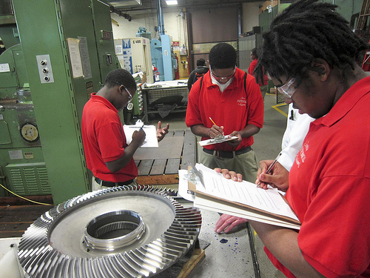
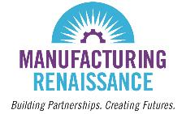
Getting More Young People Into Industrial Career Pathways:
The Chicago Experience, Austin Polytech &
Lessons Learned
Dan Swinney
Erica Swinney Staley

Slide 2
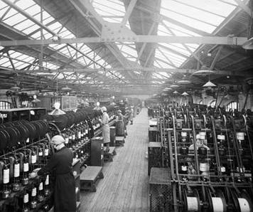
Many Americans think factories look like this:

Slide 3
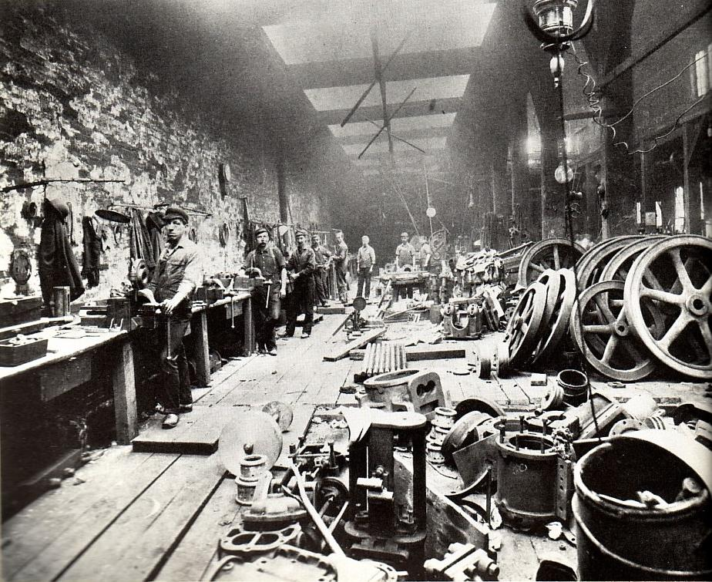
Or like this:

Slide 4

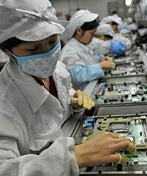
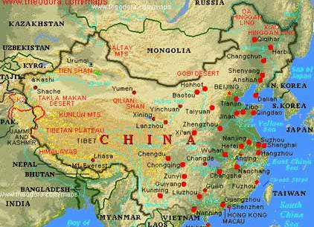
Or they’re all going here:

Slide 5
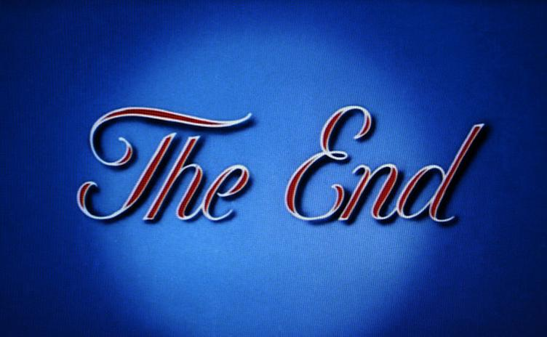

A Brief History of U.S. Manufacturing

Slide 6

A Fork in the Road
Do we accept the decline of manufacturing, our communities, and our nation?
Or do we rebuild manufacturing as the foundation for our society?

Slide 7
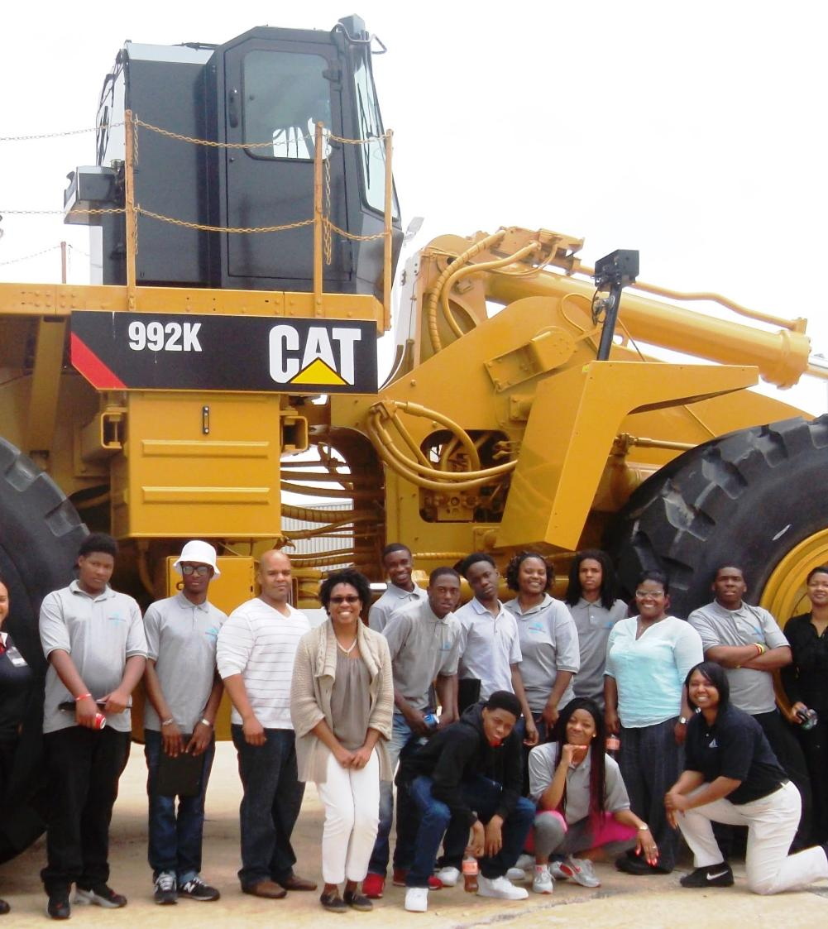
Today’s Talk
Manufacturing Renaissance: Background
Manufacturing Matters
Mondragon
Austin Polytechnical Academy:
Our approach
Lessons learned
Questions

Slide 8
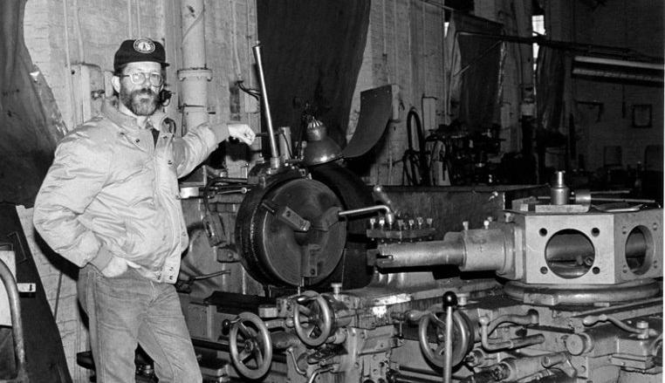
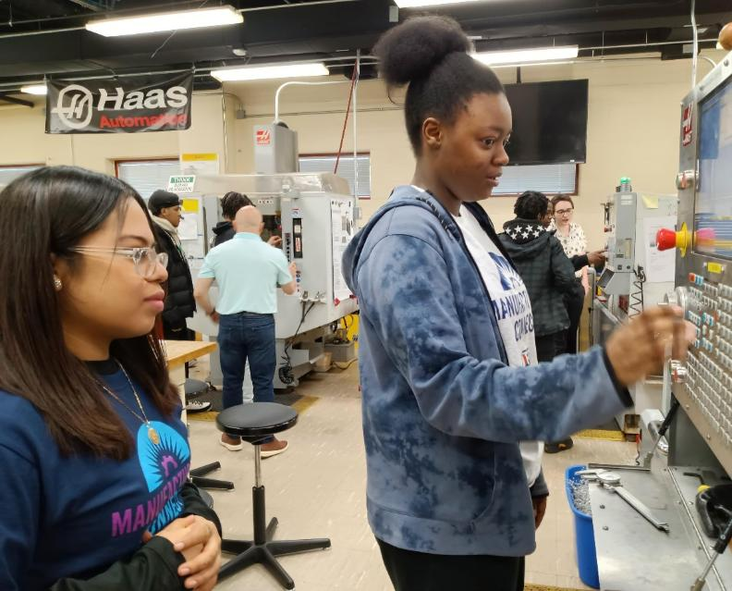
Manufacturing Renaissance (MR) formerly the Center for Labor and Community Research
MR/CLCR Founder at Taylor Forge
Mission: Advance inclusive sustainable development anchored in manufacturing.
Program Overview:
Austin Polytechnical Academy (aka Career Pathway Services): expose, inspire and prepare youth to get and keep career-track jobs in manufacturing.
Core Belief: A “high road” manufacturing ecosystem is fundamental to advancing systemic development solutions transformative for economies, individuals, families and our communities.
1983
2023
Notes:
Core belief: A “high road” manufacturing ecosystem is fundamental to advancing systemic development solutions transformative for economies, individuals, families and our communities.

Slide 9

Manufacturing Matters
The loss of manufacturing jobs facilitated the large- scale poverty, crime we see in US society today
Only sector that can build a middle class and reduce poverty
Average compensation about $110,000 annually (2025)
Each manufacturing job creates 5 jobs
Higher quality jobs
Only sector that can solve the environmental crisis
Chicago’s education system failing manufacturing
5,000 (up to 16k in 2018) jobs going unfilled every year in Chicago
59% of Black and 37% of Latinx young adults, ages 20-24, are jobless in Chicago. (UIC 2016)

Slide 10
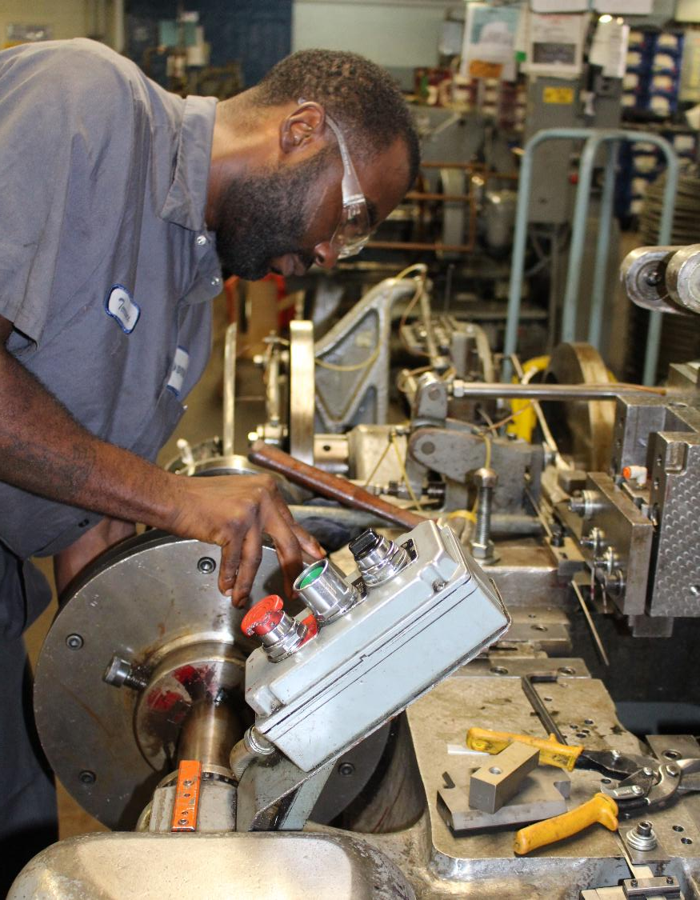
Manufacturing Matters
MR focuses on 3 major areas serving companies as well as serving communities. We are profoundly committed to inclusion in every aspect of our work.
Talent Recruitment and Retention
Ownership Succession and Early Warning Networks
Industrial Policy and the Federation for a Manufacturing Renaissance

Slide 11
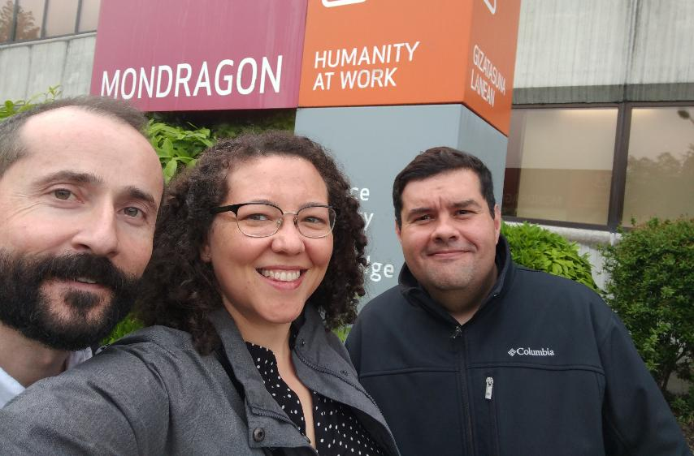
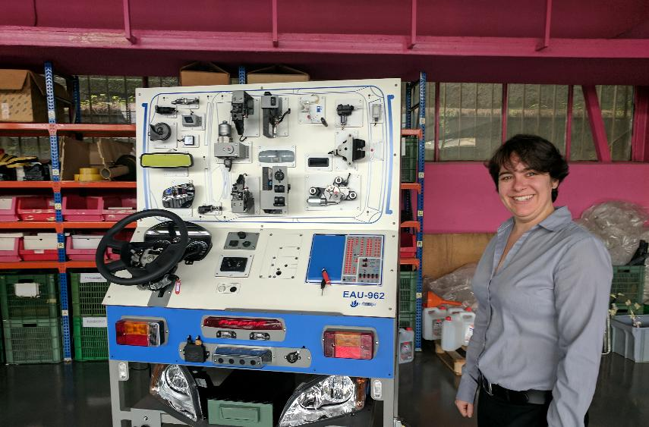
International Influences: Mondragon, Basque Country, Spain
A “polytechnical” school founded by a priest in the 1940s to train and educate region’s youth for driving economic and community development
1950s: 5 students bought a manufacturing company and organized as a cooperative
Today:
74,000 workers across a total of 268 enterprises including:
102 cooperatives
140 subsidiary companies (not cooperatives)
26 foundations and umbrella organizations
Operating in 39 countries worldwide

Slide 12
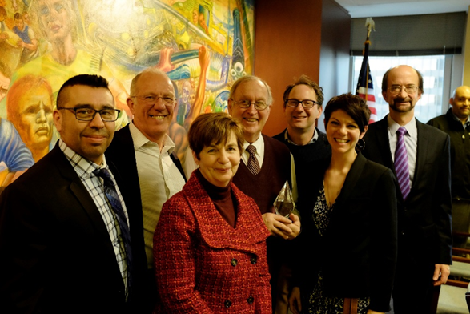
MR’s Response - From problems to prototypes
Published a 2001 Report “Creating a Manufacturing Career Path System in Cook County” which detailed the skill gaps in the workforce and education systems related to the needs of the manufacturing industry
In 2005, established the Chicagoland Manufacturing Renaissance Council (CMRC): A true public/private partnership bringing labor, education and management together in a common cause
In 2007, the CMRC, staffed by MR led the design and development of a public school, Austin Polytechnical Academy, that met the standards of modern industry and was effective in engaging low-income communities

Slide 13
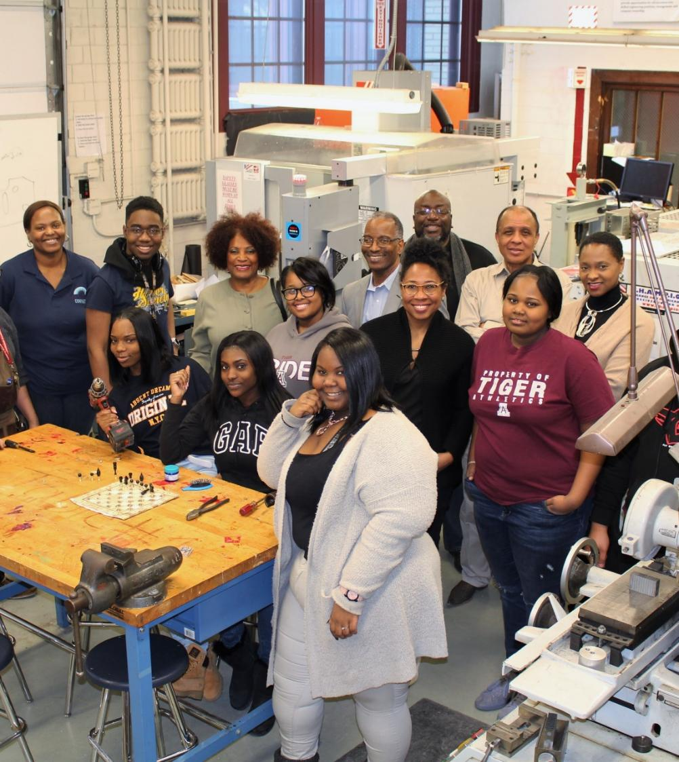

The Chicagoland Manufacturing Renaissance Council
The Chicagoland Manufacturing Renaissance Council (CMRC) is a regional coalition with the mission to:
Promote manufacturing as a tool for social inclusion and community development.
Includes:
Manufacturers and their associations​
Organized labor and their associations​
Educators and educational institutions​
Social service providers​
Community and faith leaders​
Youth and youth advocates​
Business owners and leaders​
Government officials ​

Slide 14
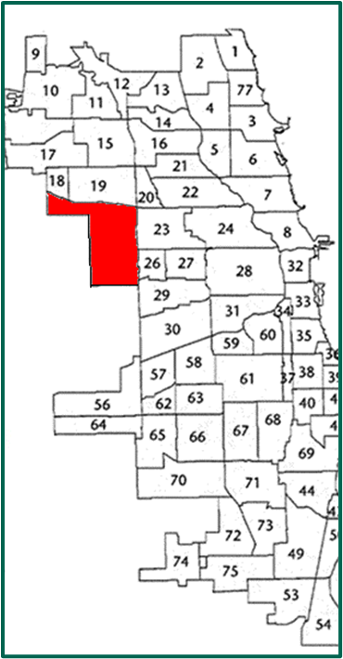

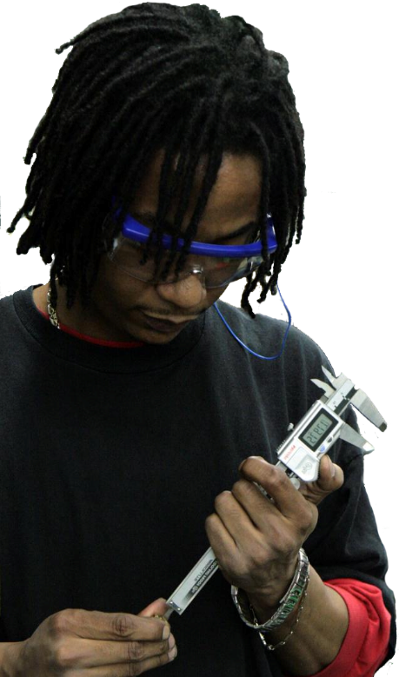
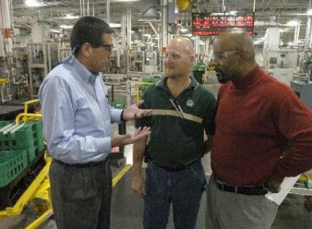
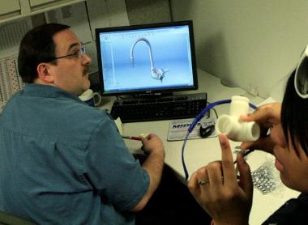
Austin Polytechnical Academy
Chief Executive
$167,280/year
College
Management
$93,650/year
Skilled Production
$38,940/year
Engineering
$80,580/year
Notes:
A career in manufacturing can of course start as a great machinist or machine operator, but with experience and education it can also lead to a diversity of other career paths including management and ownership.

Slide 15
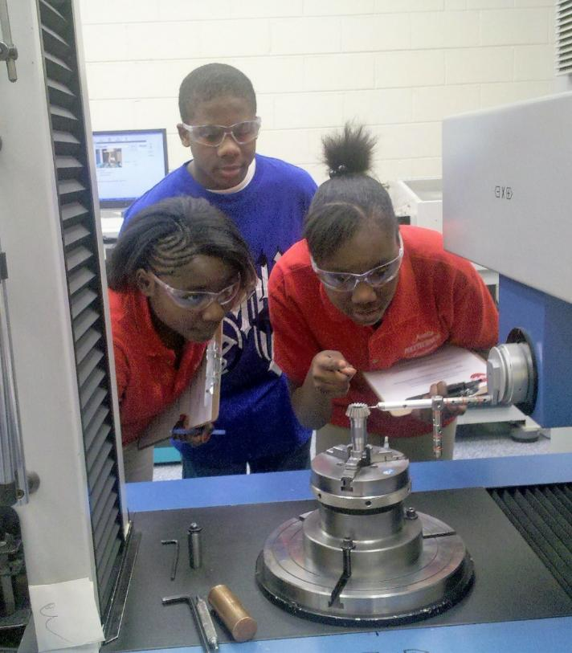
Austin Polytechnical Academy Educating the next generation of leaders in all aspects of manufacturing.
Employer Engagement
Organized quarterly meetings with the Chicago Manufacturing Renaissance Council to address broader strategic, political dynamics
Organized quarterly program industry advisory committees to inform all aspects of career prep activities, technical and training facility needs
Employed dedicated staff for employer partnership development and coordinating career exposure/work experiences for students
Teacher/Instructor/Administrator Training
Organized a program to recruit and train technically, pedagogically and culturally competent instructors for technical education
Organized multiple/regular trainings and externships for school staff to orient on the manufacturing industry and how to make connections for students between academics and career applications
Career Exposure starting in 9th grade (and sooner!)
Hundreds of Fieldtrips to industrial facilities and colleges across many types of careers in/intersecting the manufacturing industry
Organized info sessions and career fairs
Facilitated many guest speakers to classrooms, younger reps when possible!
Creating Connection & Individualized Supports
Integrated identity and community culture, many staff from the community
Social engagement and social services
Individualized development plans
Trauma-informed approaches

Slide 16
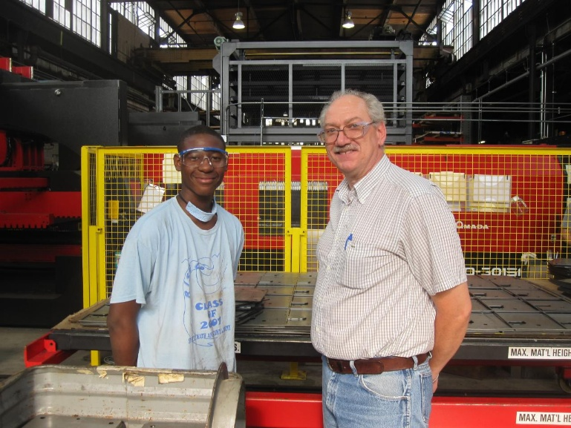
5. Technical Training and Education:
Engineering courses 9th – 12th grades: Project Lead the Way curriculum
Manufacturing technology courses 11th-12th grades hosted in a NIMS-accredited facility and opportunities for earning up to 5 industry credentials
Dual-credit courses
Work-readiness skills training
Multiple Work Experiences 10th – 12th grades
Internships over holiday breaks 10th-12th grade
1-day Job shadows 10th-12th grades
Summer jobs 10th-12th grades
MR organized average of 50 work experiences each year for students
Career Coaching and Placement
Career-track, full-time, unsubsidized jobs
Post-secondary enrollment
Apprenticeships
Job Retention Supports
Multiple touch points after placement follow up to 1-year and beyond
Convened peer support sessions – Young Manufacturers Association
Pro-active coaching
Life and Leadership Skills
Organized a student trip to Mondragon
Mentoring program
Organized robotics team and “Skills USA” chapter
Piloted cooperative entrepreneurship initiative “Mech Creations”
Organized sustainable development and leadership trainings “Eco Crew”
Austin Polytechnical Academy Educating the next generation of leaders in all aspects of manufacturing.

Slide 17
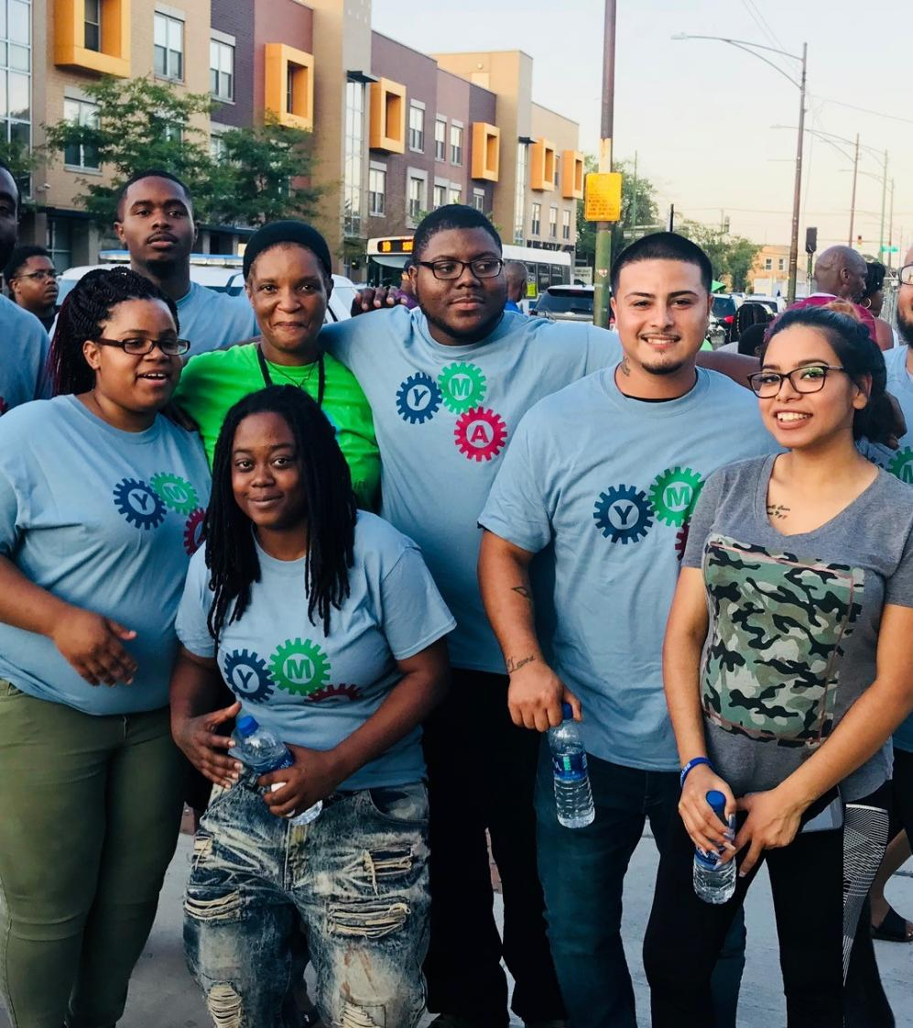
Young Manufacturers Association
Started in 2016 by program alumni in response to ongoing need for training and support on the job. Started as a peer support network for young adults pursuing careers in mfg
Serving young adults ages 18-29
Emphasizes peer support, leadership and network development, building a new identity around pursuing careers in manufacturing, not just getting the job but keeping the job and growing a career
Goal is to establish active YMA chapters across the Chicagoland area, normalize and encourage more young people to consider manufacturing career pathways
YMA Activities: youth-oriented technical training, job placement and individualized supports, peer support meetings and events, community engagement

Slide 18
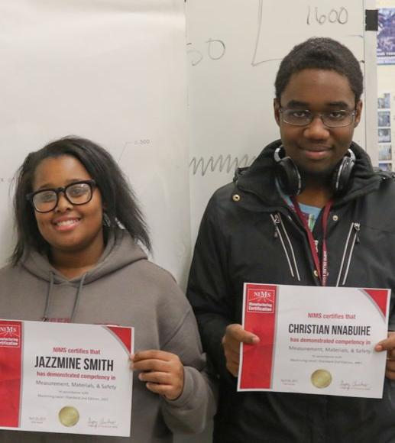
Austin Polytechnical Academy/ Career Pathway Services Results 2010 - 2022
Manufacturers Participated: 153
Total Participants Served: 476
Total Work Experiences Completed: 720 (includes job shadows, internships and summer jobs; highest # of manufacturing work experiences completed for youth/young adults in one program in City of Chicago)
Total NIMS Credentials: 361 participants earned 591 credentials (highest # of NIMS credentials earned by youth/young adults in one program in City of Chicago)
Manufacturing Job Placements:
127 program completers
182 jobs
Average retention across all placements: 15 months
90-day retention average: 76%
Average wage: $18.55/hr plus benefits

Slide 19
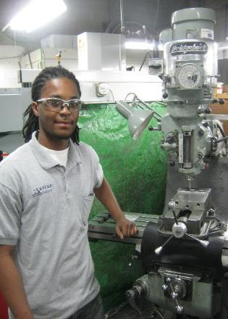
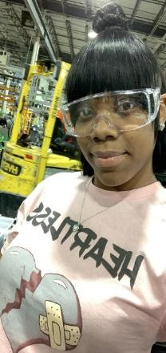
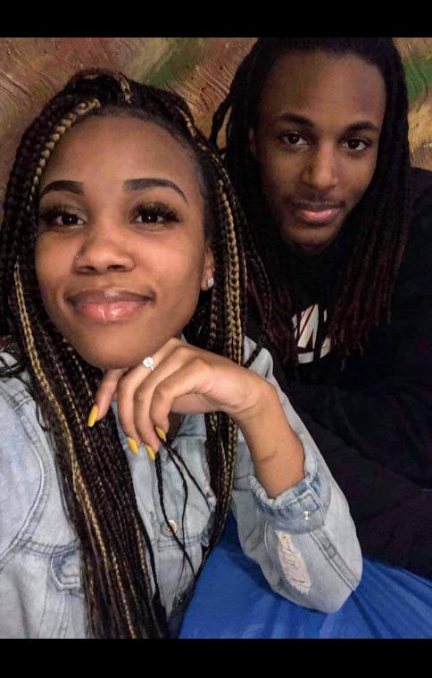
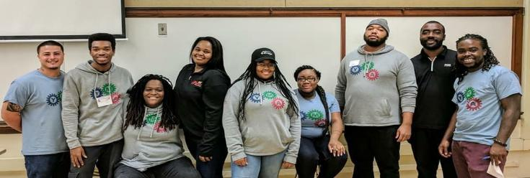
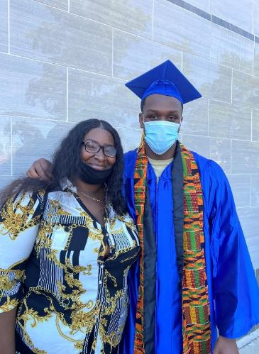
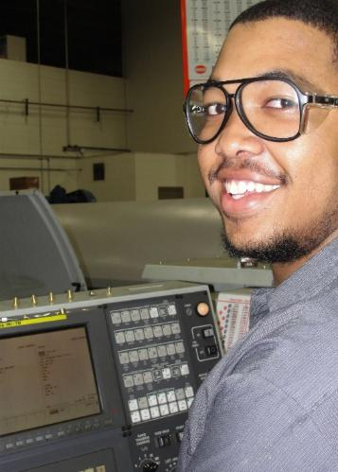
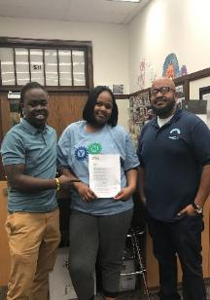
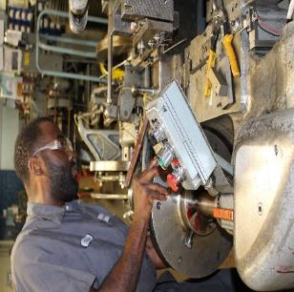
This is what success looks like

Slide 20
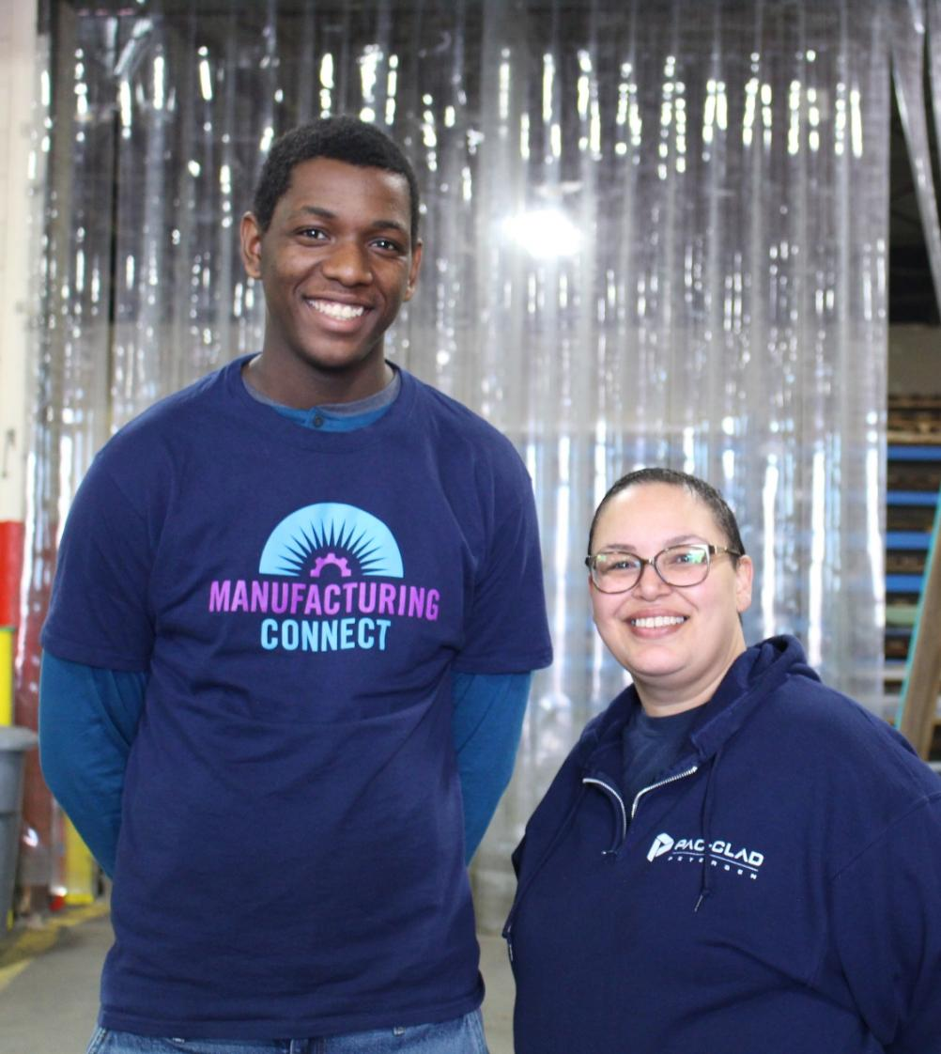
Part of the Solution – What We’ve Learned
It takes a village to build a diverse, manufacturing talent engine!
Manufacturers and their Associations
High Schools/Districts
Colleges/Trade Schools
Labor organizations
Community-based & faith organizations
Local government & social service agencies
Civic, community, business leaders
Youth!
Everyday is Manufacturing Day!
Multiple and varied opportunities year-round to learn about manufacturing, normalize manufacturing!
Multiple opportunities & multiple chances to opt in
Meet young people where they are, i.e., Relationships, respect and trust come first, interest, commitment and loyalty come later
What’s in it for me? What’s in it for my institution? Make room for and make clear everyone’s self-interest

Slide 21
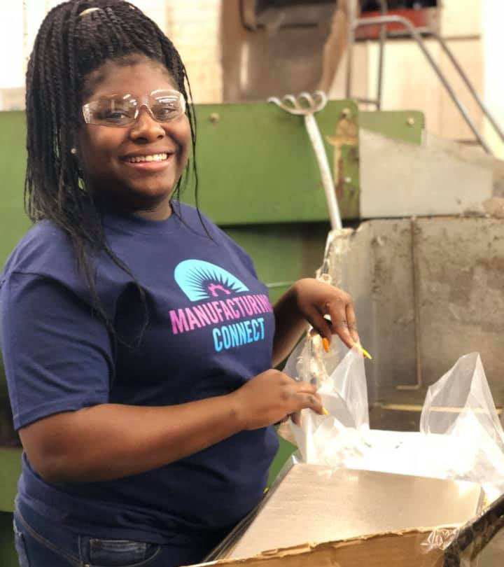
Part of the Solution – What We’ve Learned
More “low barrier” career exposure, career training, job placement and retention support opportunities are needed
Training duration/scheduling
Training location
Training prerequisites and application process
Paid vs. unpaid training
Who are your instructors? Do they have:
Technical skills – Of course!
Pedagogical skills?
Cultural skills?
Programs that are equal (ish) parts:
Skills building: Technical skills, work-readiness skills, project-based learning, hands-on
Supportive: Coaching, referral partnerships w/other social services, assistance with transportation, childcare other unexpected/emergency needs, mentoring, life skills
Socially, professionally and civically engaging through new peer groups, networking, giving back, fun!
Fosters developing a vision for the future: Cultivate a culture of continuous learning, exposure to new tech, entrepreneurship, community development, “dynamizers,” etc.

Slide 22
Part of the Solution – Programs as Prototypes to Build an Inclusive Manufacturing Ecosystem
Early Warning Network
Manufacturing Succession Solutions
Young Manufacturers Association
Manufacturing Connect
Austin Polytechnical Academy
Instructors Apprenticeship for Advanced Manufacturing
Mfg Ecosystem Services
Chicagoland Manufacturing Renaissance Council
Federation for a Mfg Renaissance

Slide 23
Thank you!
Dan Swinney
dswinney@mfgren.org
Erica Swinney Staley
ejswinney@gmail.com
www.mfgren.org

